Slide 1
Case study Turkey
Carbon Pricing Communications Training
Banu Buyurgan

Slide 2
Turkish communications strategy
Policy Formulation
Communication
Strategy v1
Policy Formulation Revision
Communication Strategy v2
Policy Adaptation
Notes:
..

Slide 3
National
Challenges/Circumstances
Low level of concern on the carbon and its impact on climate change e.g. air quality.
Lack of interministries’ consensus regarding the carbon price.
Lack of engagement and (political) ownership at high-level policymakers in building support.
Cost abatement.
Economic unstability.
Lack of continuity.

Slide 4
National Challenges/Circumstances
Carbon pricing would be seen as an additional cost for private sector and the citizens.
Concern on use of revenue.
Concern on the impact of electricity cost.
Concern on negative impact on economical growth.

Slide 5
Objectives
Pro-actively communicating on carbon pricing policy.
Gaining and maintaining support for carbon pricing policy.
Building internal support within Government.
Making the carbon price signal visible to limited carbon intensive industry and businesses.
Countering misinformation and misunderstandings on carbon pricing.
Obtaining feedback from stakeholder groups.
Ensuring that the carbon price is robust and broadly understood and supported by all key stakeholders .

Slide 6
Primary target audiences
Internal Groups | Politicians Ministry of Environment and Urbanization Ministry of Treasury and Finance Ministry of Energy and National Resources Ministry of Trade and Technology Presidency of Strategy and Budget Other ministries and governmental bodies | External Groups / Primary stakeholders | Finance institutions Carbon intensive industry The Union of Chambers and Commodity Exchanges of Turkey (TOBB) Regional Chambers of commerce and industry Voluntary organizations of the private sector (TUSIAD, MUSIAD, DEIK, TIM YASED) Academy NGOs Media

Slide 7
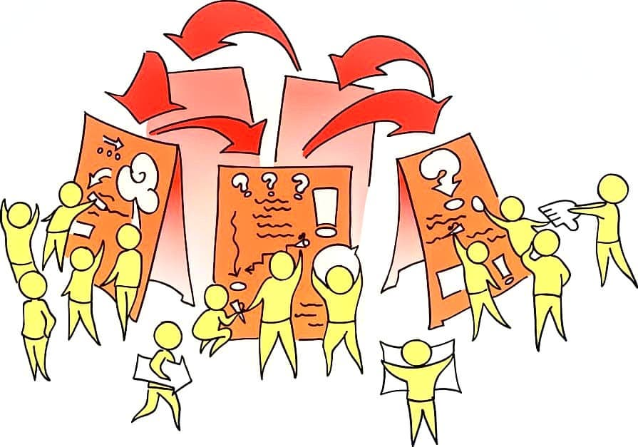
Stakeholder Meetings
To create awareness
To inform
To engage
To listen and obtain feedback
To build sustainable support
To communicate costs
To explain reasons for carbon
pricing

Slide 8
PESTEL analysis
Identified the primary target audiences
Formed the narratives
Identified the relevant pros and cons as well as threats and opportunities in terms of political, economic, environmental and legal factors according to the target audiences
Benefits: Clean energy, green economy, renewable energy, new job opportunities, being competitive

Slide 9
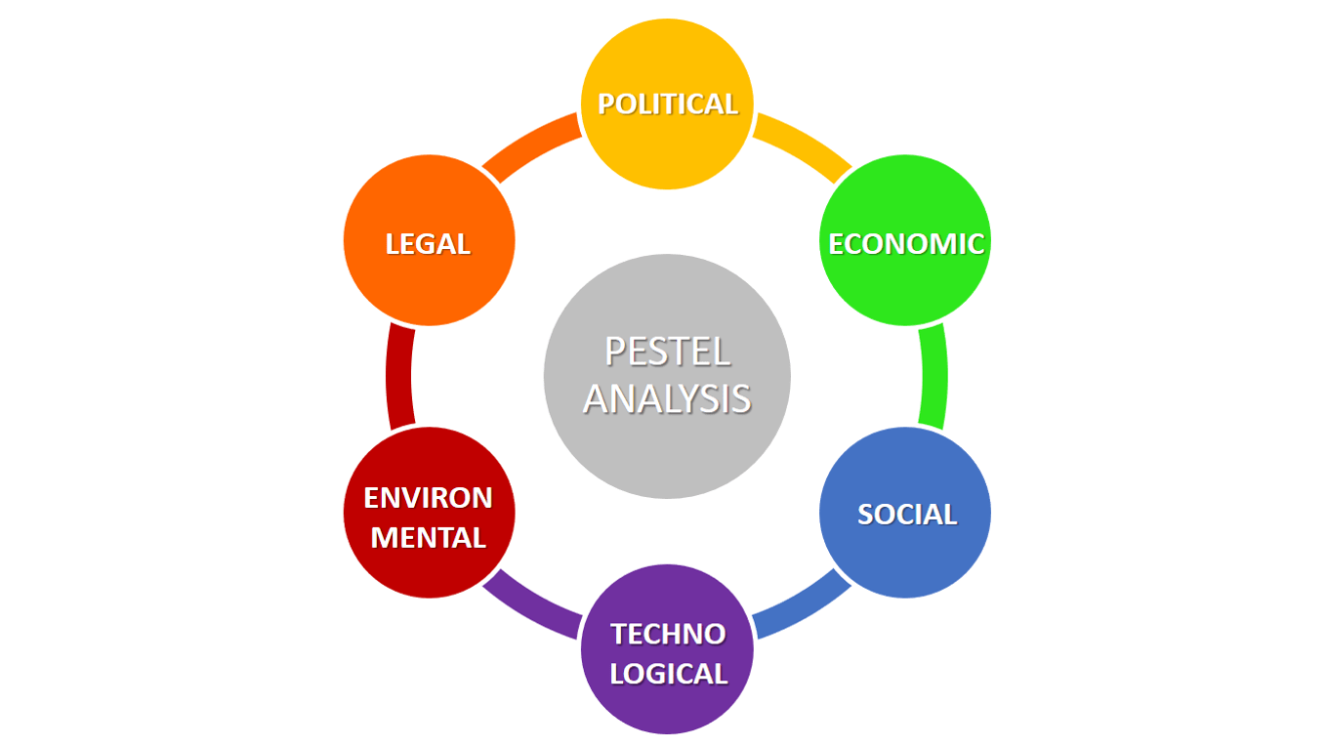
Prep Pestel
Government
Academy
Media
Private Sector / Industry
NGOs
Notes:
..

Slide 10
Narrative Strategy
Prioritization
Carbon Pricing
Risks & Opportunities
Climate Change
Carbon pricing is for modernisation of
our econmy (green economy, income
and job opportunities, global
competitiveness and co-benefits) and
the energy sector (renewable
energy transition and clean
energy).

Slide 11
How can engage the businesses and carbon intensive indusrty ?
Mobilizing the Trusted Communicators
The presidents of chambers of commerce and industry | Business leaders in the industry | Politicians High level / senior Policy makers | Experts (Economists, etc.) | Media (Economy editors Columnists)

Slide 12
Facilatitors for engagement of stakeholders (external)
Media
Carbon intsensive sector
Business Leaders
Experts
NGOs

Slide 13
Facilatitors for engagement of stakeholders (internal)
Politicians
(political ownership)
Government

Slide 14
Communications tools
Engagement of key stakeholders:
  Meetings with primary stakeholders (one-to-one meetings, workshops, search conferences)
Engagement of media:
  Media partnership for TV programs and supplements on climate change, green economy, clean energy, energy transition, green jobs, sustainable development
  Media round tables
  Media trainings on climate change journalism
  Press trips to the best practice country

Slide 15
Communications tools
Media trainings for the high level policy makers at the Government
Mobilization of communicators (experts) for NGOs
Engagement of trusted communicators for businesses, industry and NGOs

Slide 16

Case Study-Industry Engagement
Using media as a facilitator for
engagement of C level at industry
CEOs meeting in April 2018 with
participation of 200 CEOs from
industry and finance
«Climate Change» magazine
supplement of Capital and
The Economist (Ekonomist)
Notes:
..

Slide 17
Narratives for External Stakeholders Engagement
The public-private sector collaboration is the necessary condition for a better management of the climate change risks. Don’t forget that risks always bring opportunities in its wake.
We expect the private sector to make the necessary arrangements and employ the practices in order to make clean production, adapt to green economy and benefit from its opportunities. As the state, we will give our support to and stand back of you within that period.
We have to be globally competitive; therefore, we have to be integrated into green economy.
Emissions trading system and carbon pricing policies and the key elements of green economy and clean energy.
Transition to green economy is a must for private sector and the state to attract global investments.
Turkey is prepared to be a stakeholder of the opportunities of green economy.

Slide 18
Case Study – Engagement of Industry and Businesses
Video on Climate Change & Carbon Pricing CEOs’ Meeting
Meeting of CEOs

Slide 19

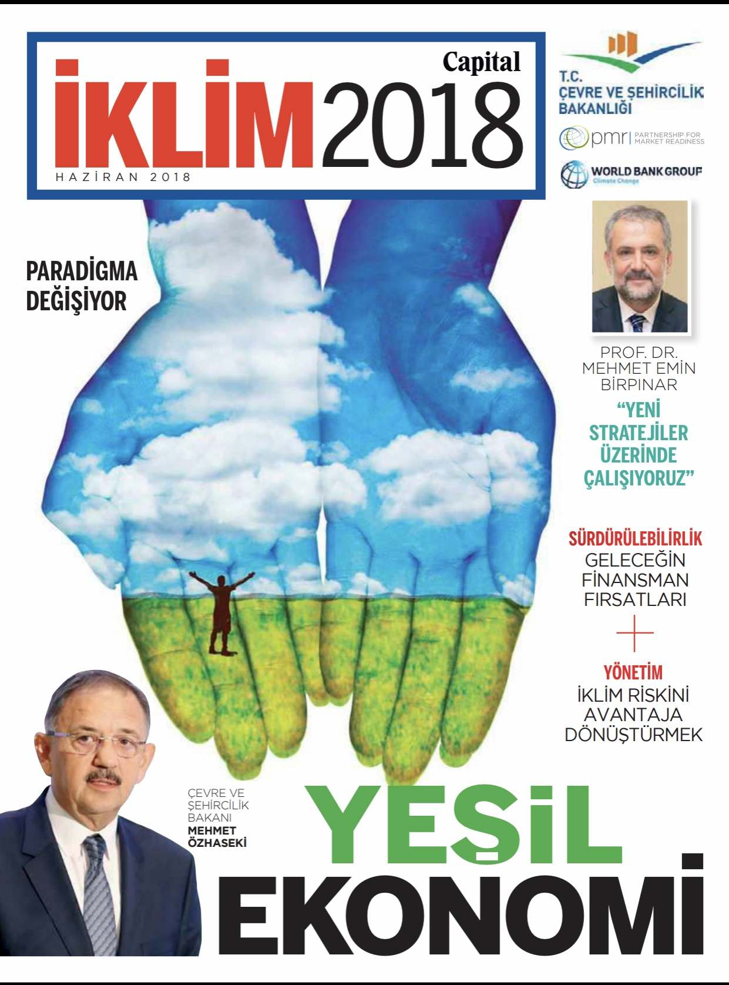
Engagement through media
Reaching out
60.000 readership

Slide 20
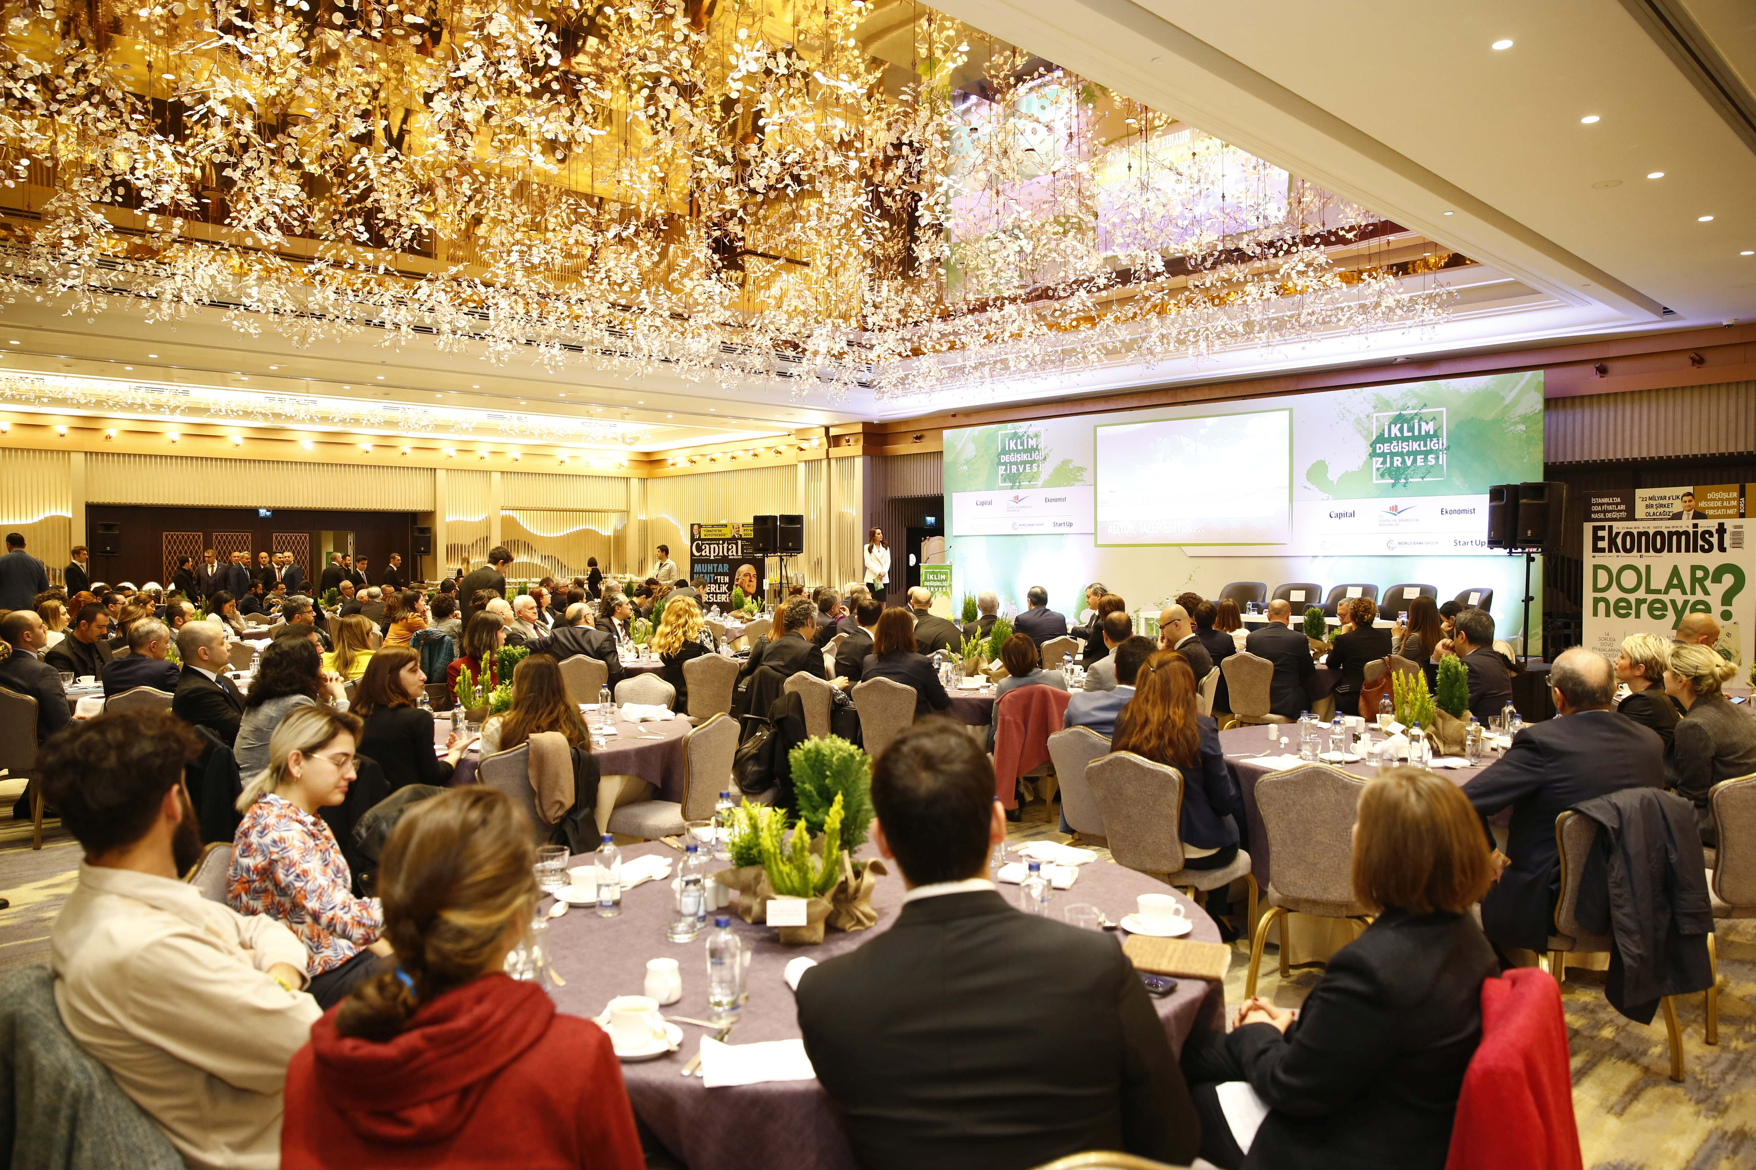
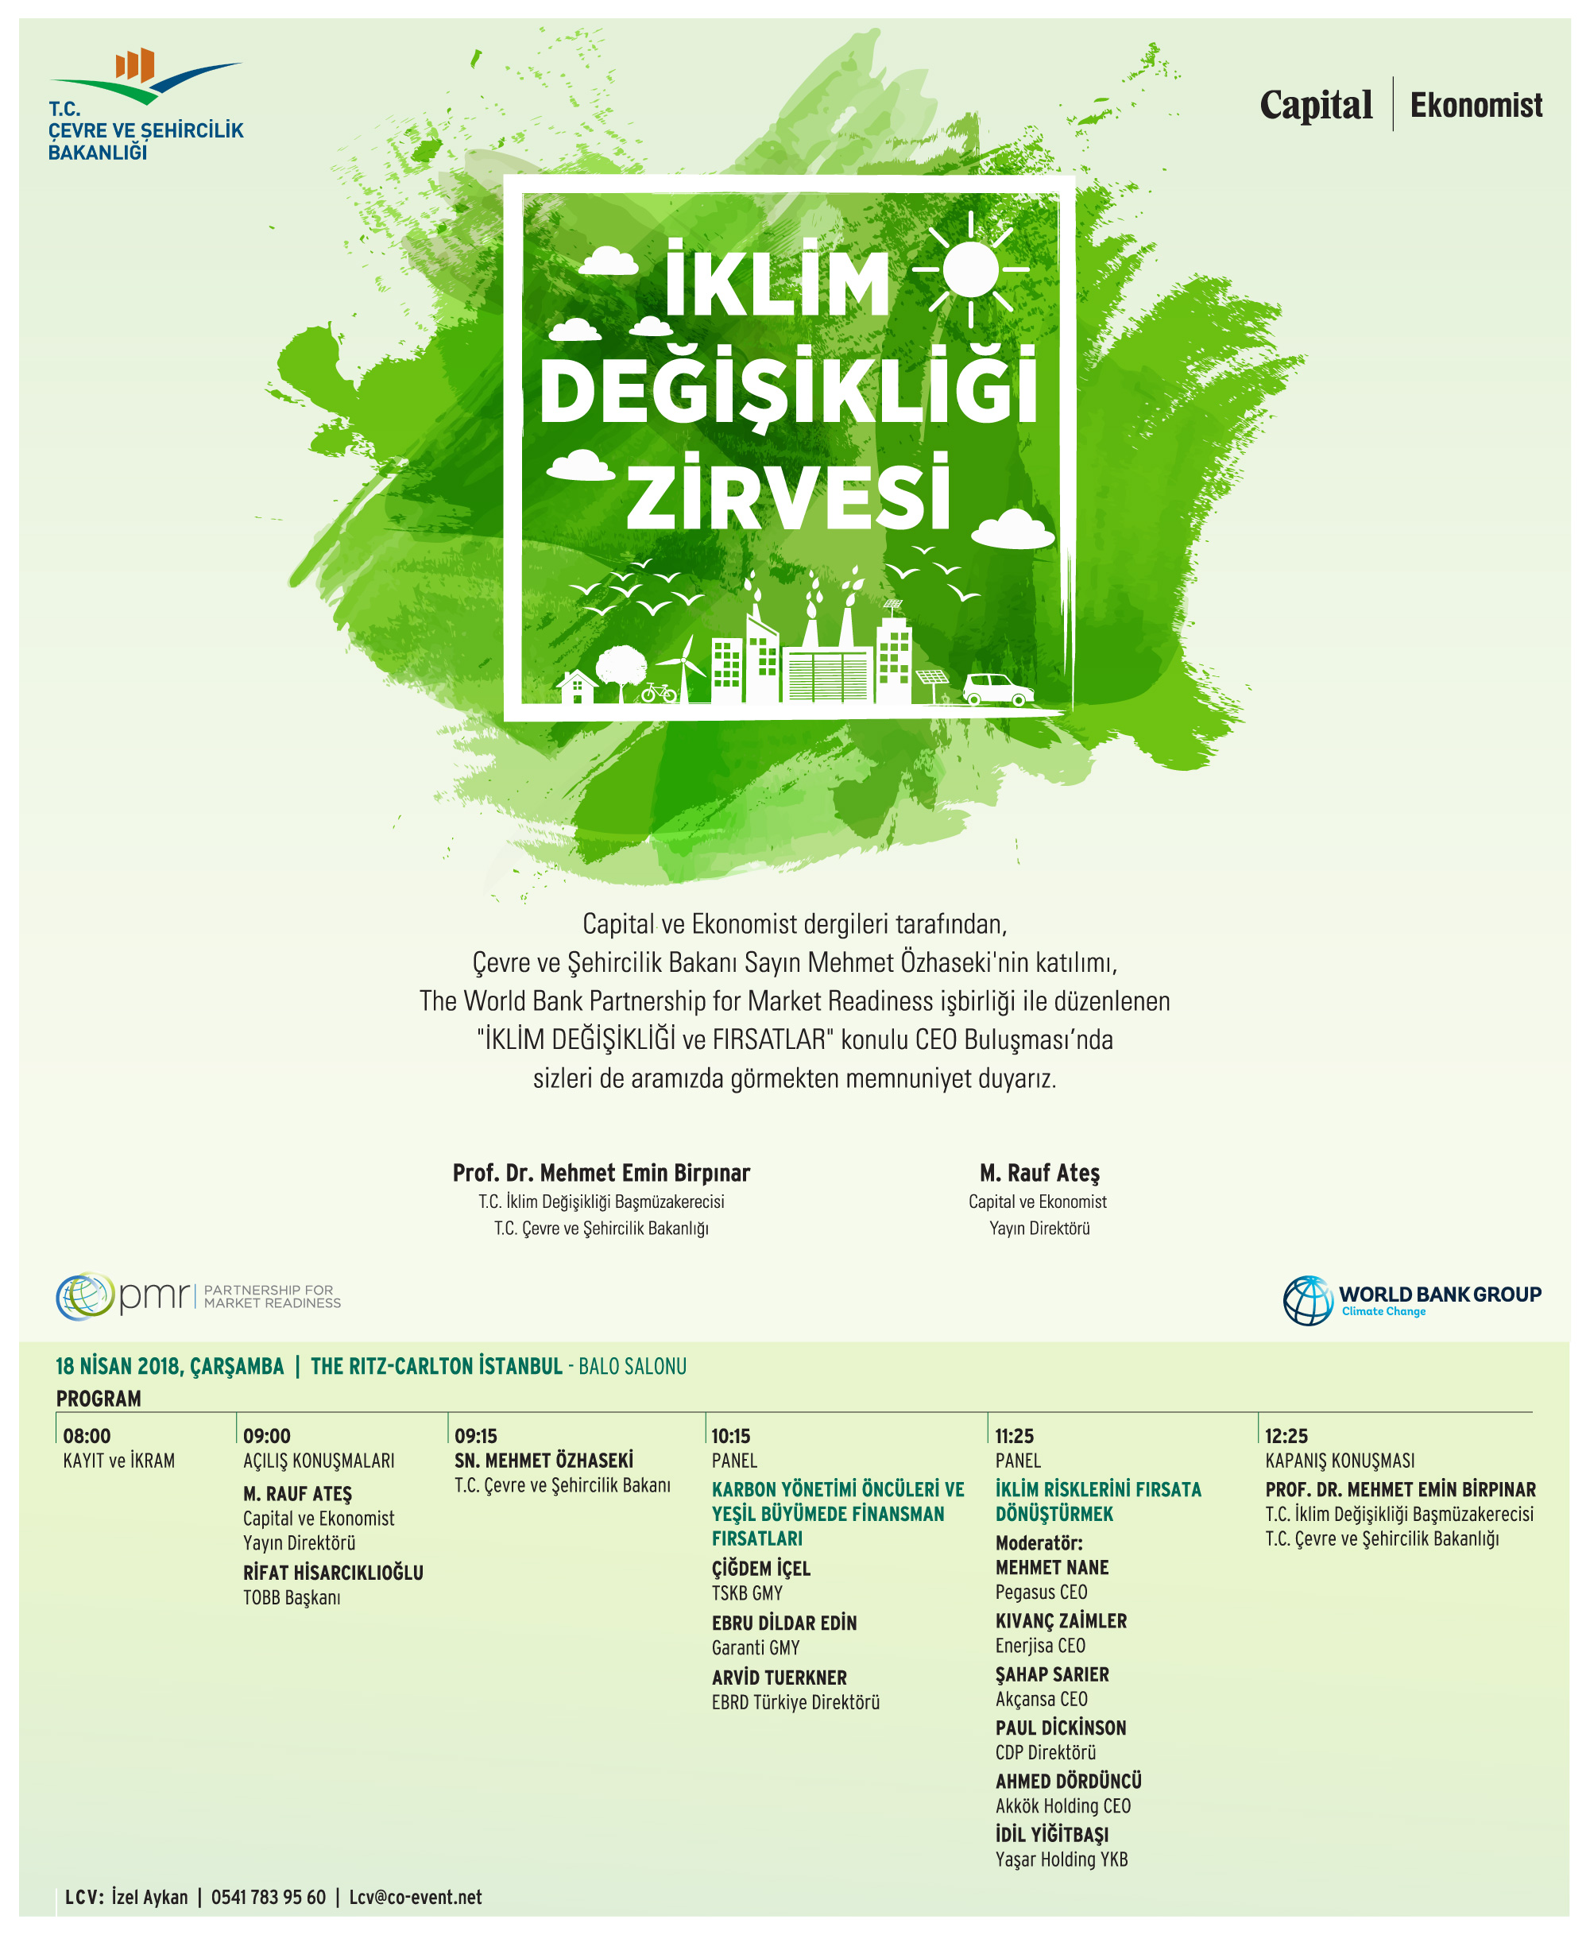
CEOs Meeting on Climate Change
12 April 2018, İstanbul

Slide 21
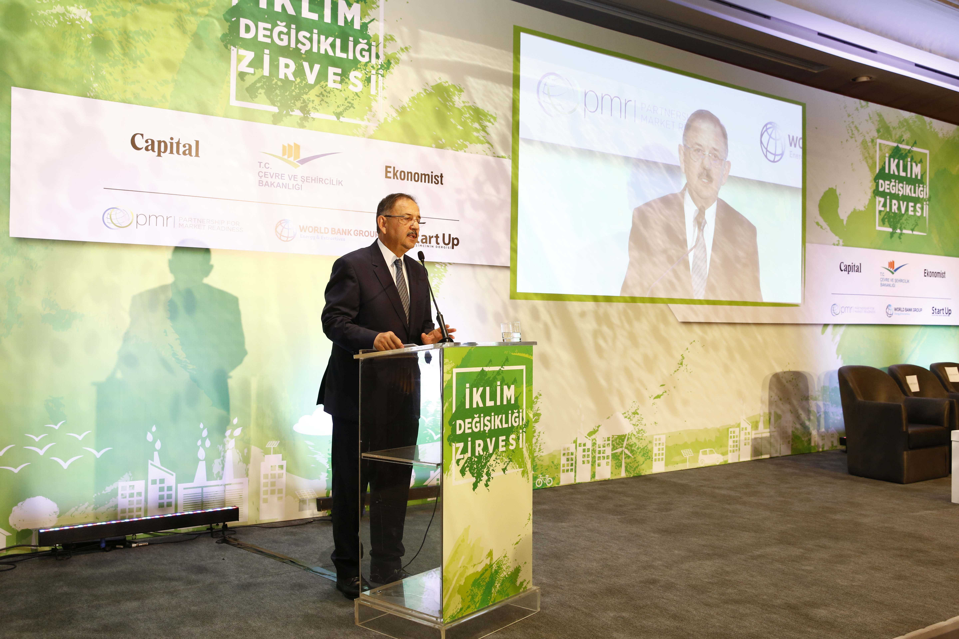
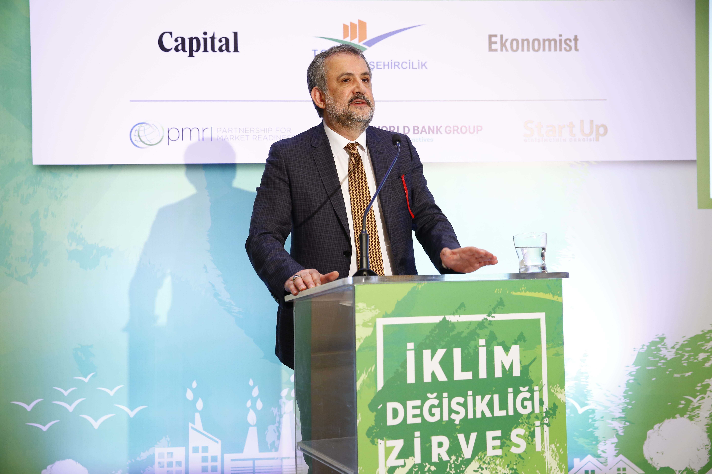
CEOs Meeting on Climate Change
Minister of EU Mehmet Özhaseki Deputy Minister of EU & Climate Change Envoy Prof. Dr. Mehmet Emin Birpınar

Slide 22
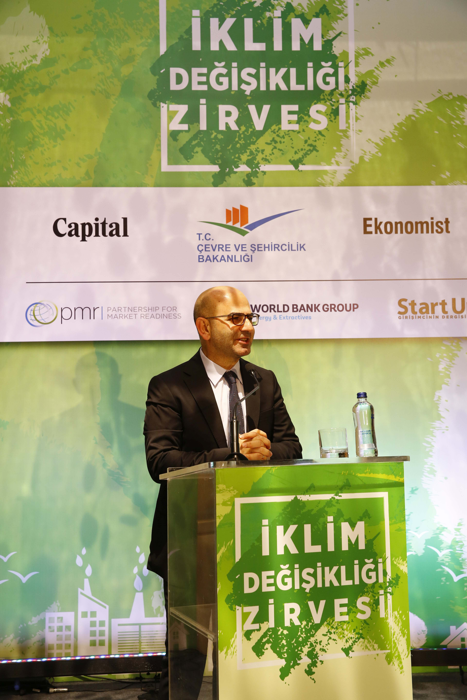
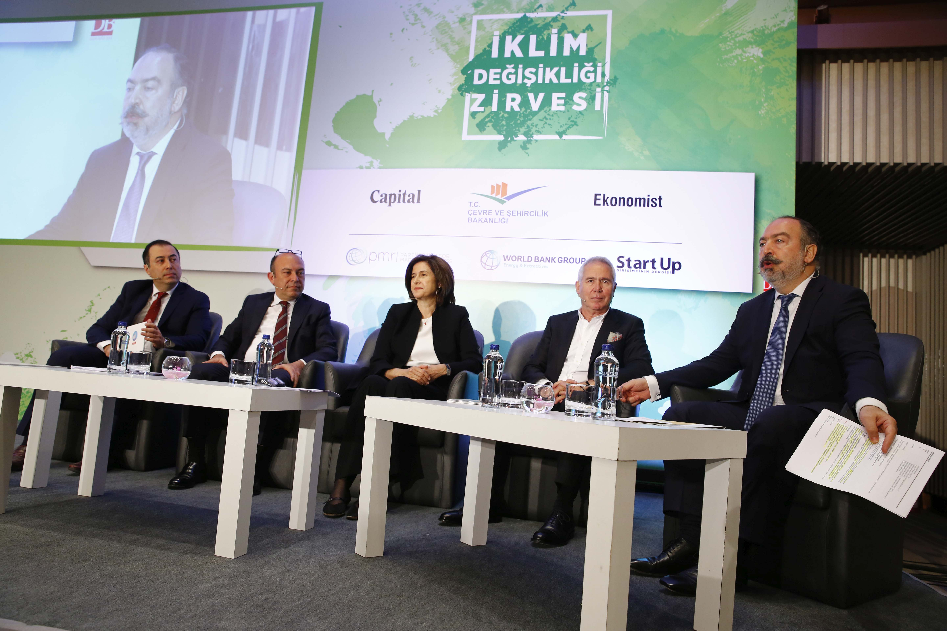
Panel on Transforming Climate Risks into Opportunities
Rauf Ateş
Editor in Chief of
Capital &
Ekonomist
Magazines

Slide 23
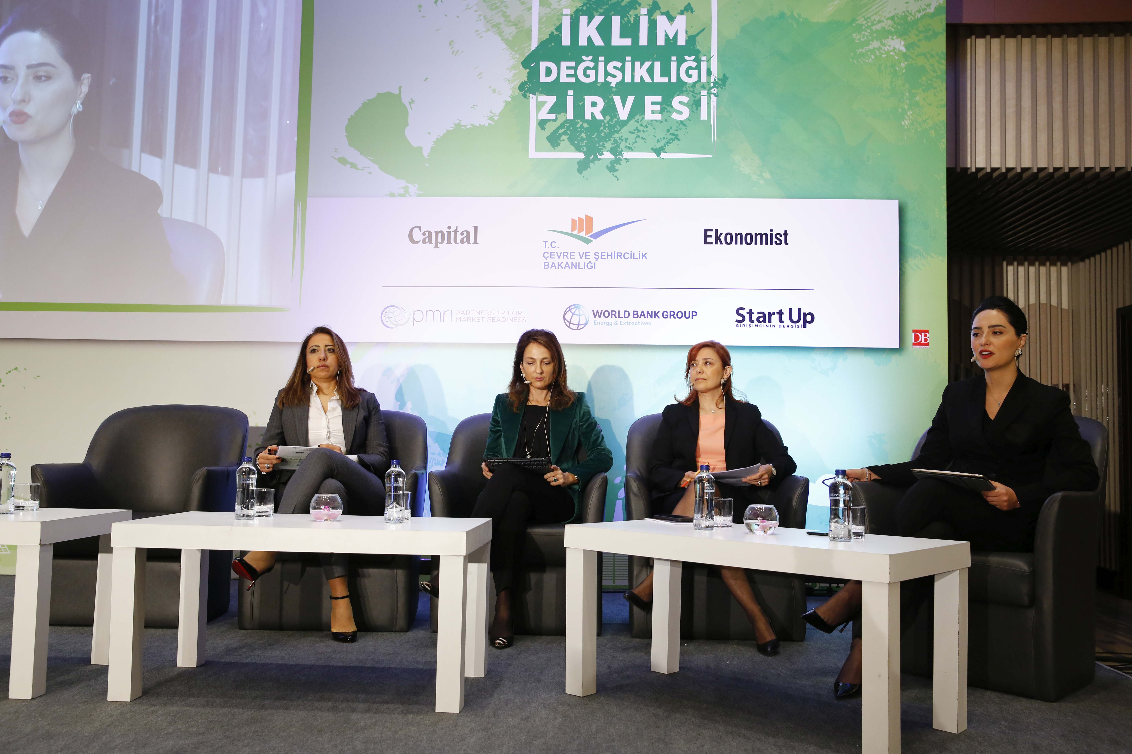
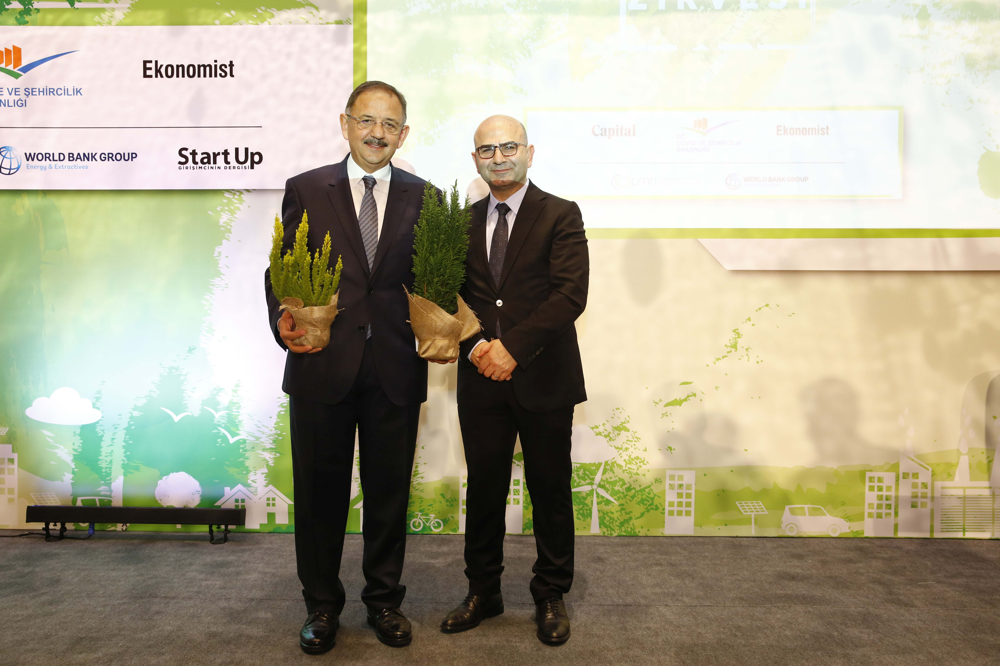
Panel on Financial Opportunities in Green Economy

Slide 24
Questions?

