Slide 1
Costa Rica: Assessing climate finance options for transformation
Silvia Charpentier

Slide 2
Definition of Climate Finance
No clear definition
Demand: investments developing countries
Supply: domestic, international, public, private
Accounting issues
Use: transformation, paradigm shift, make irreversible changes in the way we produce and consume
UNFCCC (4.3): ‘new and additional’ and ‘polluter pays principle’
IIED (2015) Steel, Paul. Development finance and climate finance http://pubs.iied.org/16587IIED.html?k=Climate%20finance&r=p

Slide 3
COP 21 decision 1/CP.21
Developed countries strongly urged to “scale up their level of financial support, with a concrete road map ”to achieve $100bn goal;
“Significantly increasing adaptation finance from current levels”;
Developed countries “intend to continue their existing collective mobilization goal through 2025”;
Prior to 2025, “the meeting of the Parties to the Paris Agreement shall set a new collective quantified goal from a floor of USD100billion”
http://www.v-20.org/wp-content/uploads/2016/03/WRI-climate-finance-accounting-presentation-V20-WG.pdf

Slide 4
Paris Agreement, Article 9.4
“The provision of scaled-up financial resources should aim to achieve a balance between adaptation and mitigation, taking into account country driven strategies, and the priorities and needs of developing country Parties, especially those that are particularly vulnerable to the adverse effects of climate change and have significant capacity constraints, such as the least developed countries and small island developing States, considering the need for public and grant-based resources for adaptation.”
http://www.v-20.org/wp-content/uploads/2016/03/WRI-climate-finance-accounting-presentation-V20-WG.pdf

Slide 5
Up until now
Broad strokes of direction of global economy for low carbon climate resilient development
Still work to be done in aligning financial instruments to recognize opportunities
Behavior of MDBs and others not yet convergent (e.g. SDGs and Paris Agreement)
Developing countries to rethink development strategies

Slide 6
Costa Rica: assessing the options
Population 4.823 million 2015
Population growth 1.2%
Area 51,000 m2
GDP US$ 50 bn

Slide 7
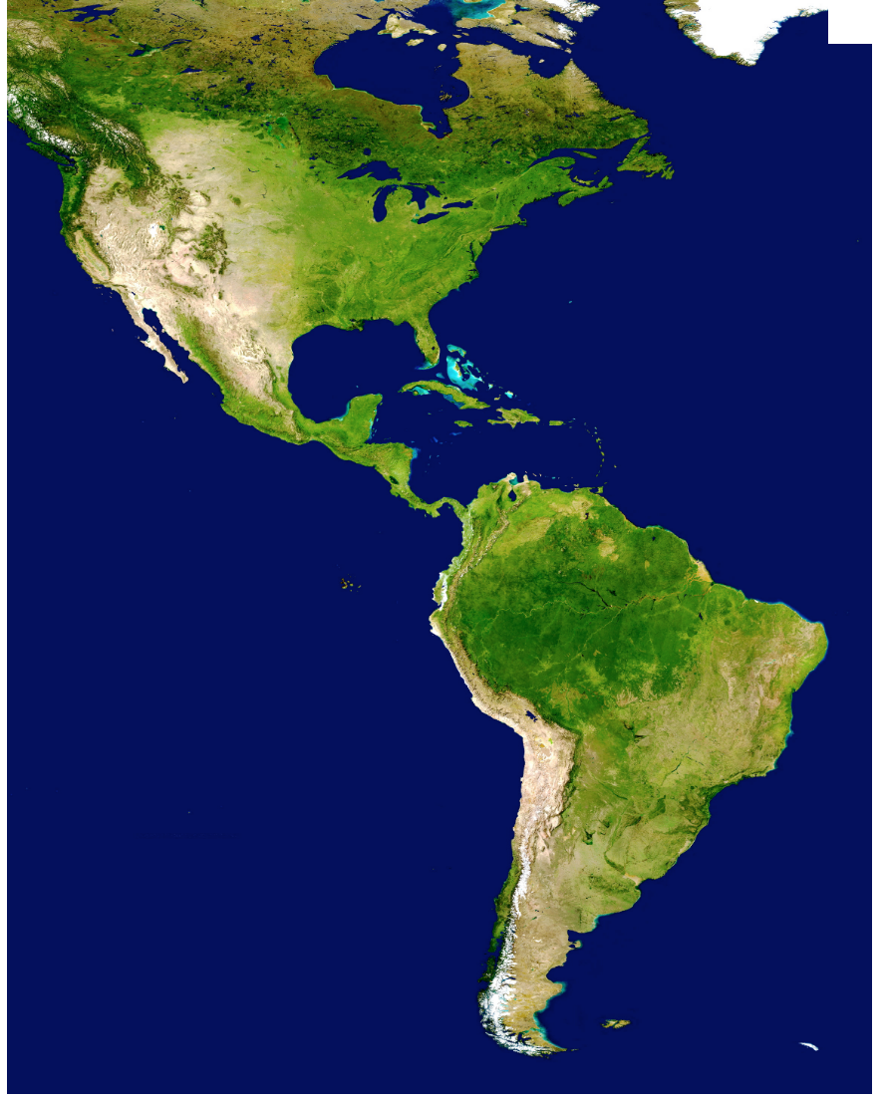

Slide 8
MITIGATION CONTRIBUTION
GHG Emissions Goal: 9.37 million tCO2e for 2030
Equivalent to a 44% reduction compared to BAU
25% reduction compared to 2012 emissions.
This implies a reduction of 170,500 tCO2e year on year to 2030.
Long-term trajectory leads to net Carbon Neutrality between 2050 and 2100.

Slide 9
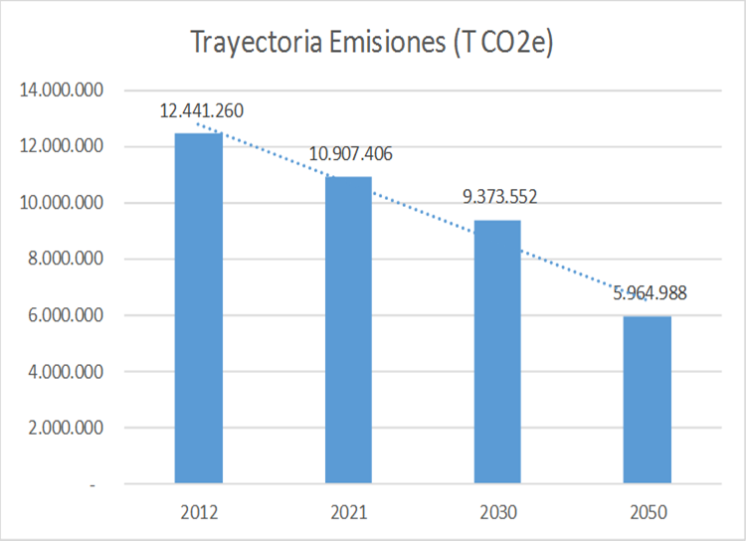
Proposed net GHG Emissions Trajectory
Costa Rica 2012-2050 (tCO2e)

Slide 10
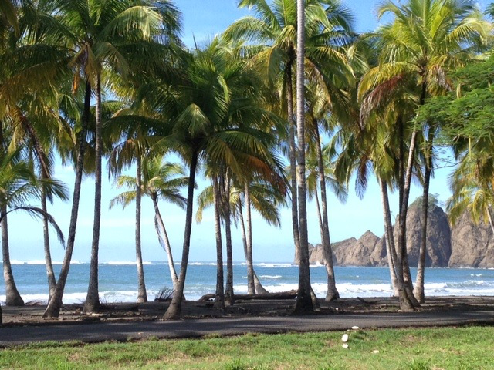

Slide 11
Climate risk of flooding
IMN. (2014)
Notes:
IMN

Slide 12
Climate risk of droughts
IMN. (2014)
Notes:
IMN

Slide 13
How to think about climate finance
Paris Agreement
  Transformation that changes the future of the planet
  Forces revisiting conventional wisdom
Strategic long term vision
  Transformational, includes NDC goals and biophysical constraints and opportunities to development
  Social, economic, sustainable development goals
  Adaptation and mitigation

Slide 14
Meaning-making of climate finance
Access: readily available, assured and lowest cost
Use: selective
Paris Agreement: national nature of adaptation and mitigation policies/ means of implementation
Respect becomes responsibility in use of financial resources
  Including debt sustainability

Slide 15
Back to Costa Rica: nationally determined strategic vision
Readiness proposal to GCF (broad view)
Governance for climate finance
Alignment of objectives
  NDCs – pathways to mitigation objectives
  Adaptation - pathways
Policy coherence (explicit and implicit policies aligned, barriers identified)
Priority setting
Portfolio of projects
  Domestic
  International

Slide 16
Finance: below the line
Best conditions in financial flows
  Bring in Ministries of Finance and Central Banks
  Common language
Domestic
  Public
  Private
International
  MDBs
  Bilateral
  Commercial
  Private
Platforms for private investment, including carbon finance

Slide 17
Challenges
Project preparation
Markets/Carbon pricing instruments readiness
  Data collection and management
  Baseline setting
  MRV
  Capacity building
  Policy design with parameters
  Stakeholder engagement
Adaptation and loss and damage
Forestry

Slide 18
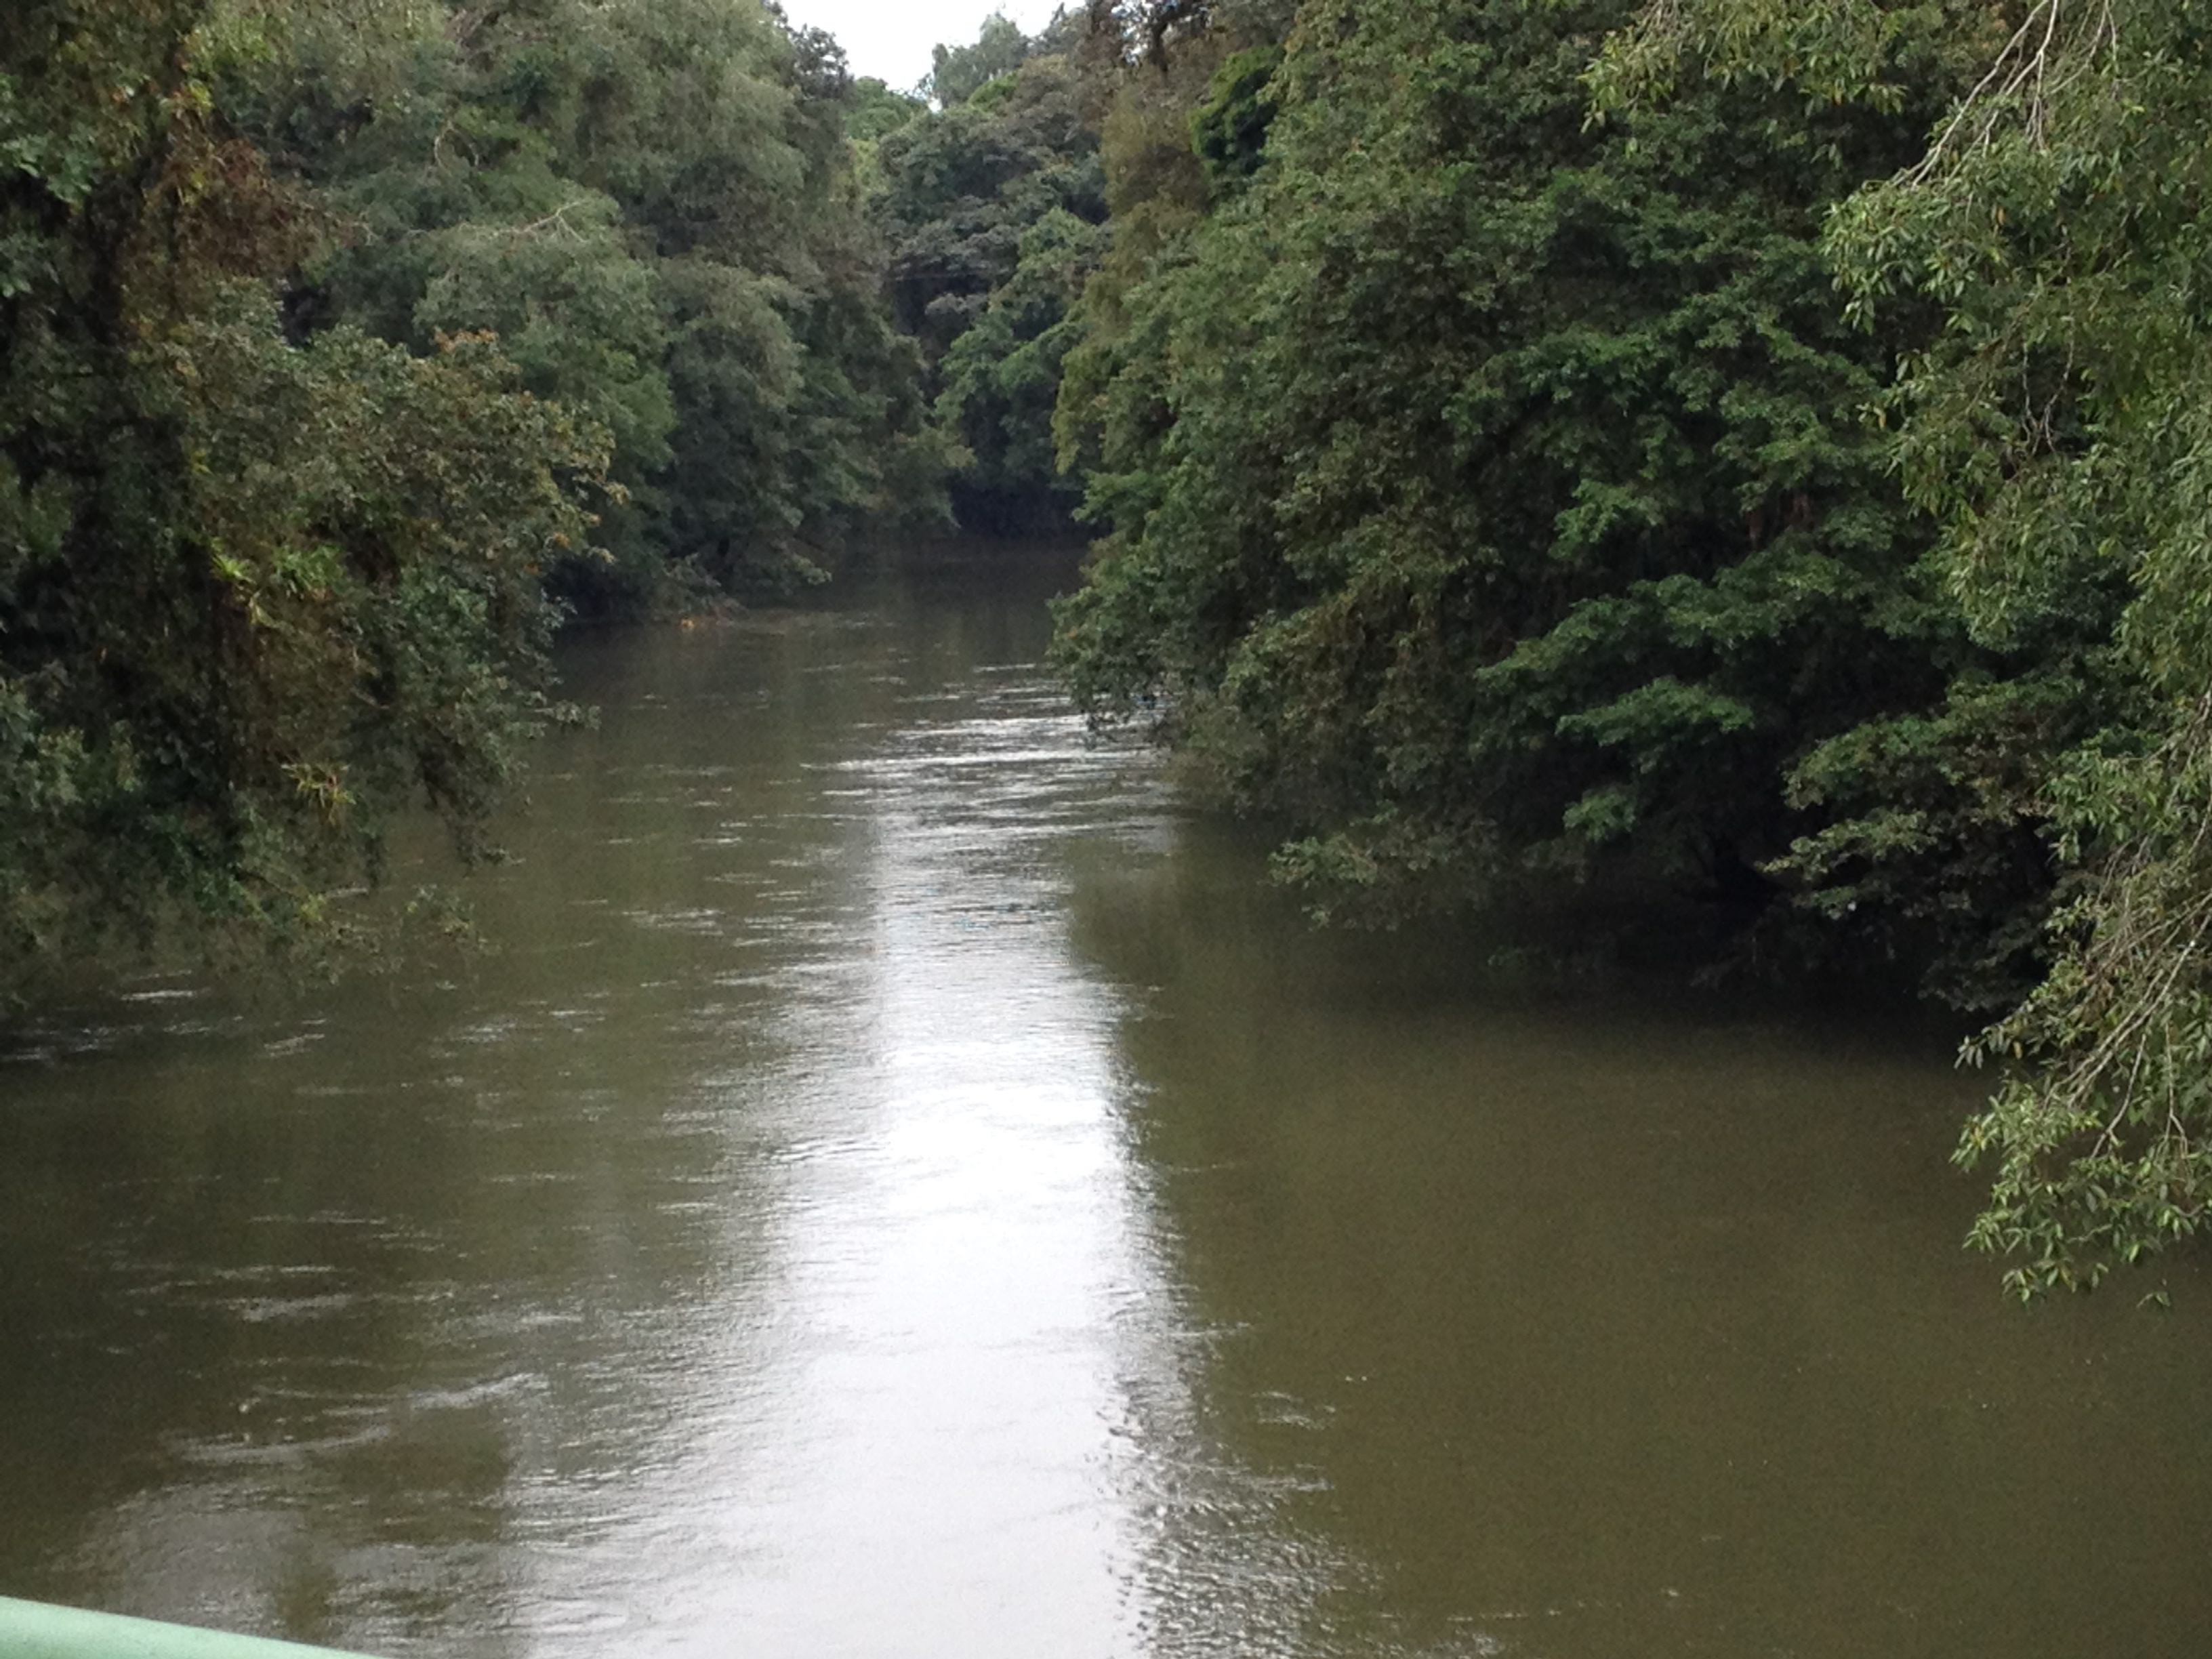

Everything is still to be done…

